Slide 1

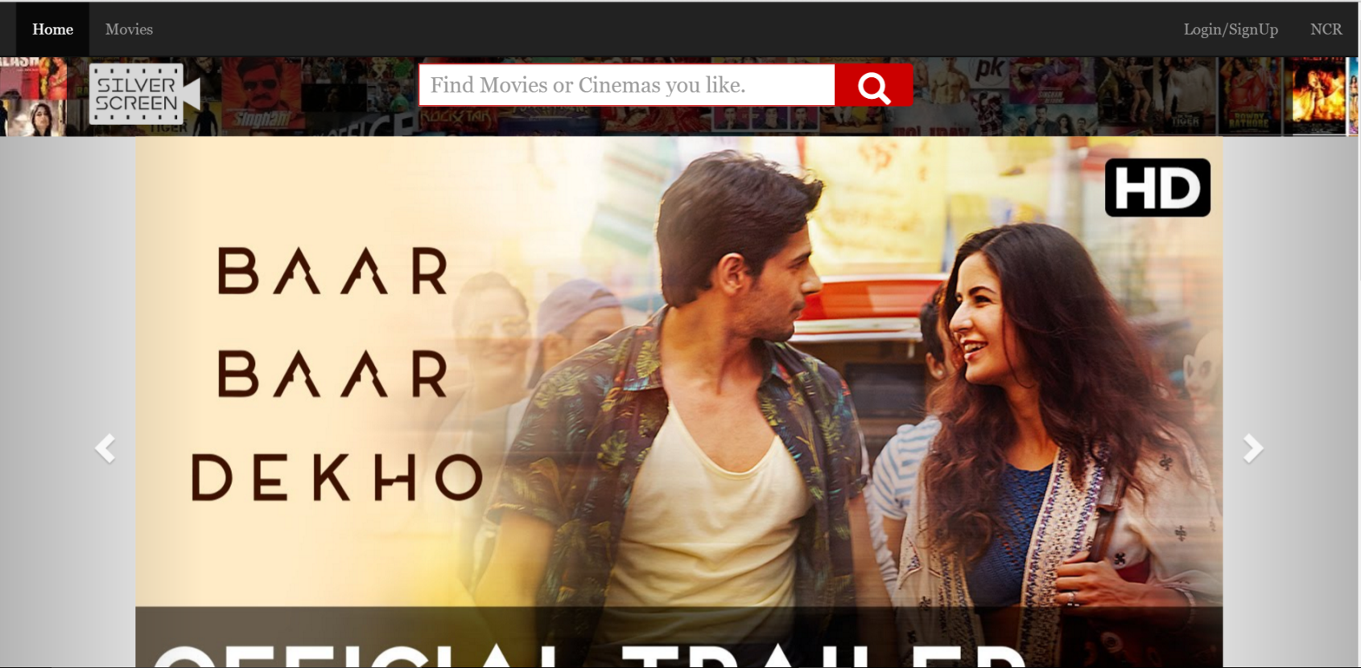
Silver Screen Making your Movie experiences Shine.

Slide 2
What is Silver Screen ?
Silver Screen is an online Movie Show Booking Portal.
It provides facilities such as :
View and Explore Latest Releases.
Check out Upcoming Releases.
Search Movies and Cinemas around You.
Book according to your convenience.
Get movie Recommendations based on your past booking history.

Slide 3
Flow Diagrams Overall Flow

Slide 4
Home Page Flow

Slide 5
Search Page Flow

Slide 6
Movies Page Flow

Slide 7
Login Flow

Slide 8
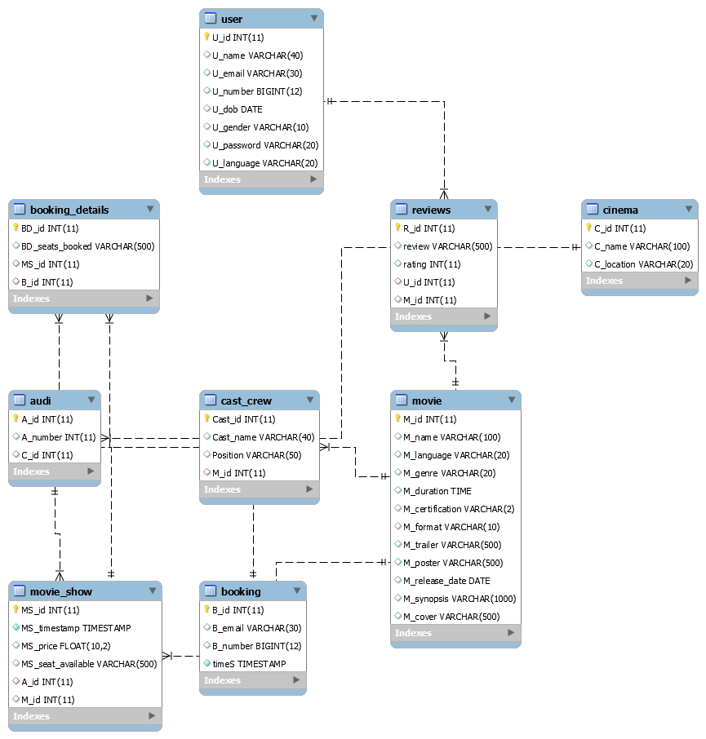
Database Schema

Slide 9

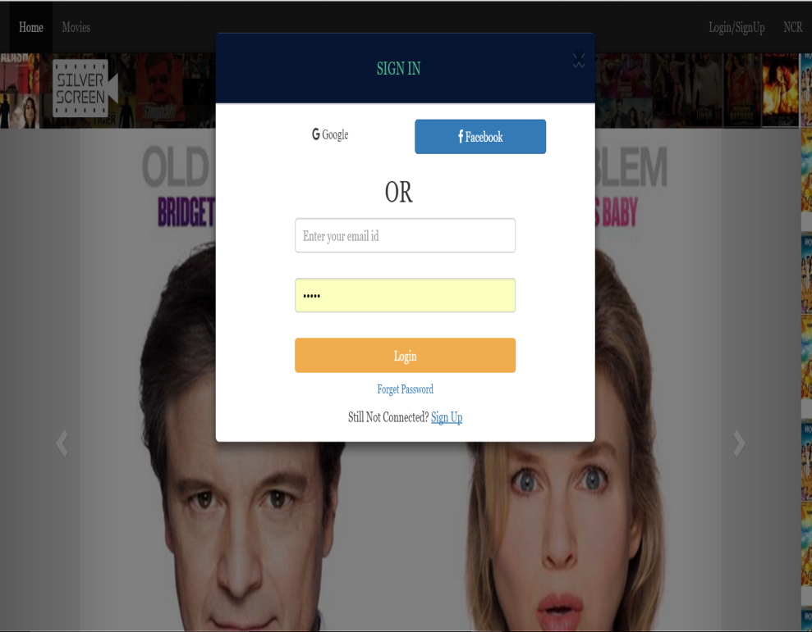
Glimpses

Slide 10
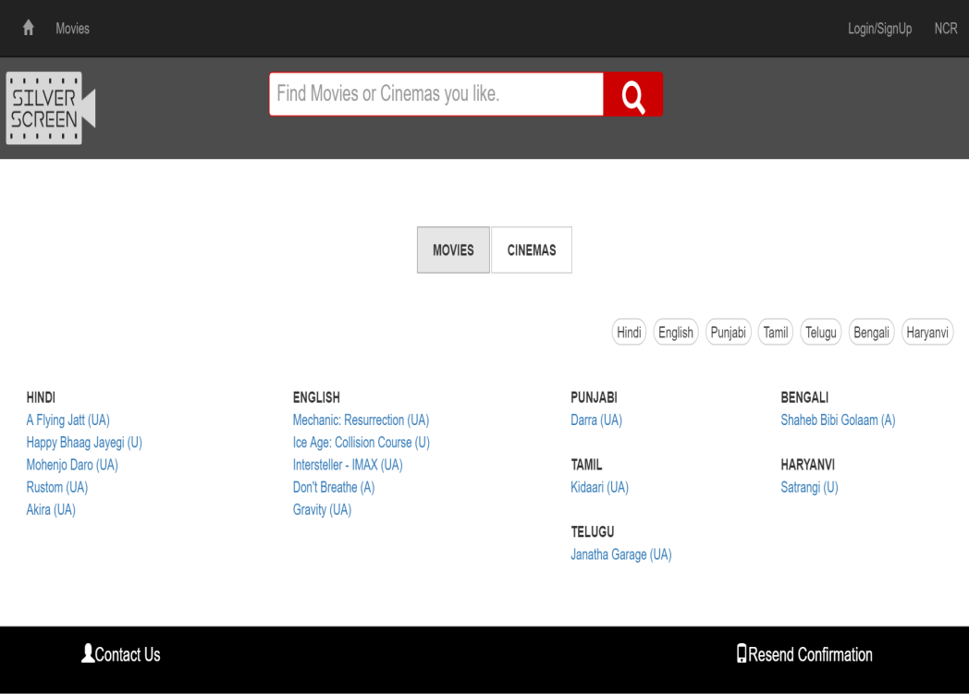
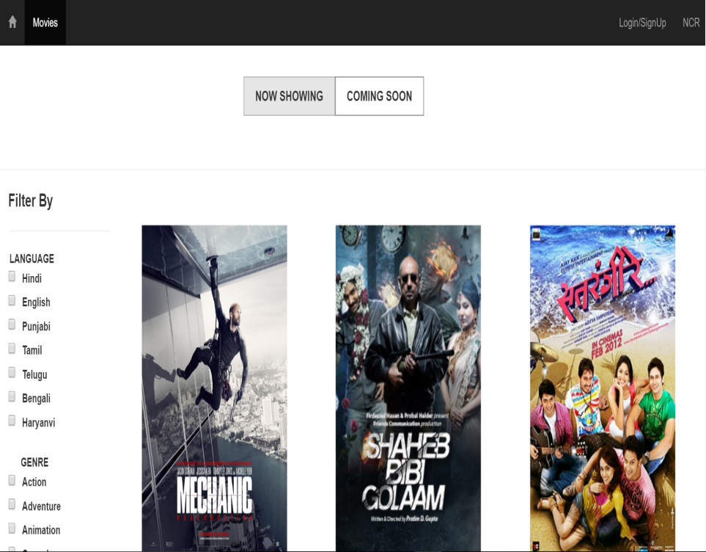
Glimpses

Slide 11
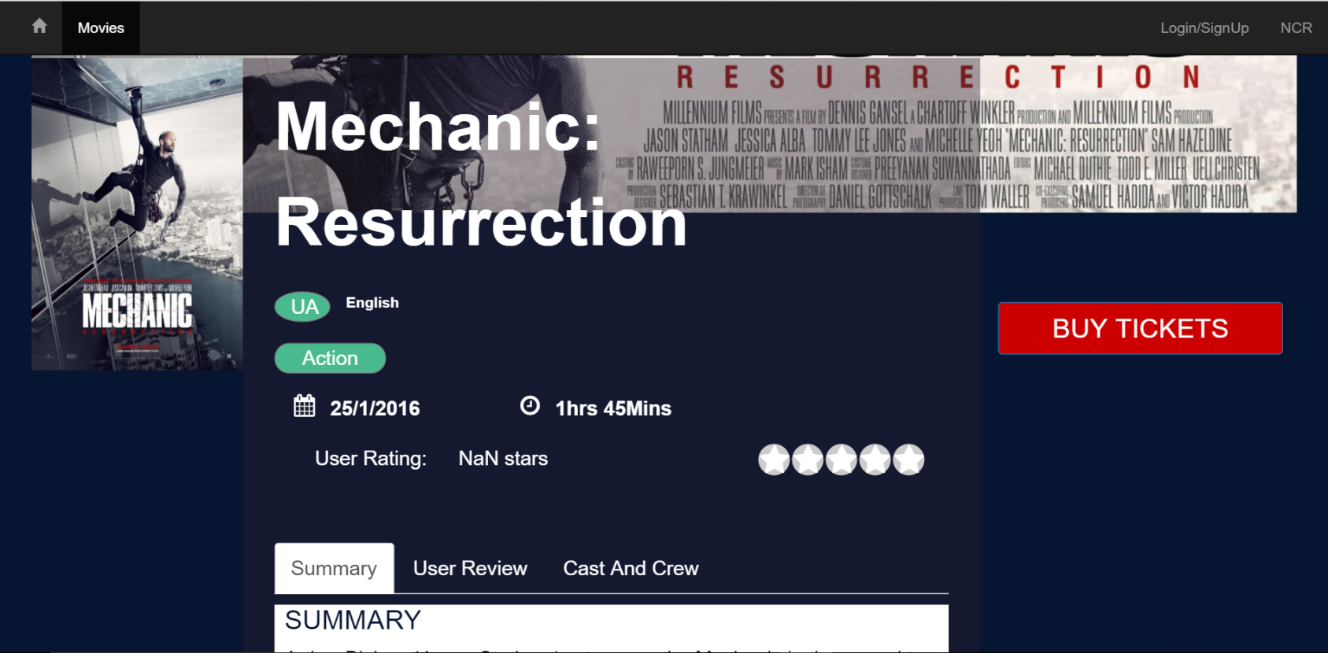
Glimpses

Slide 12
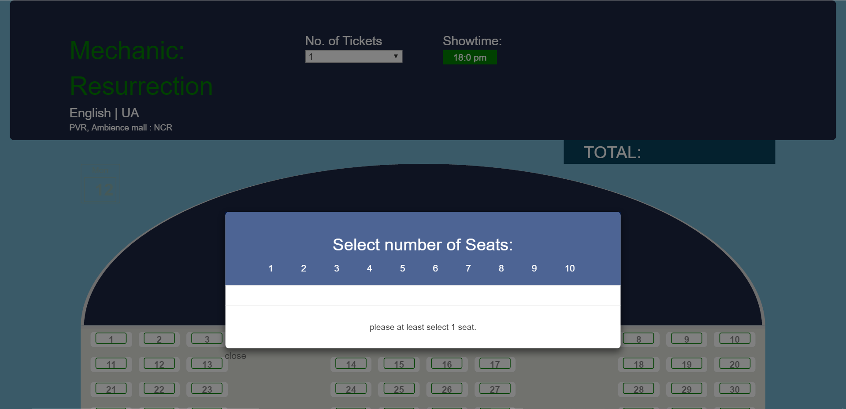
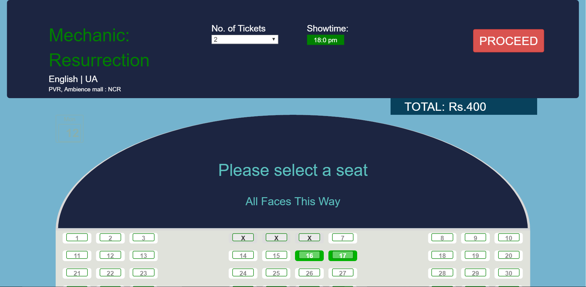
Glimpses

Slide 13
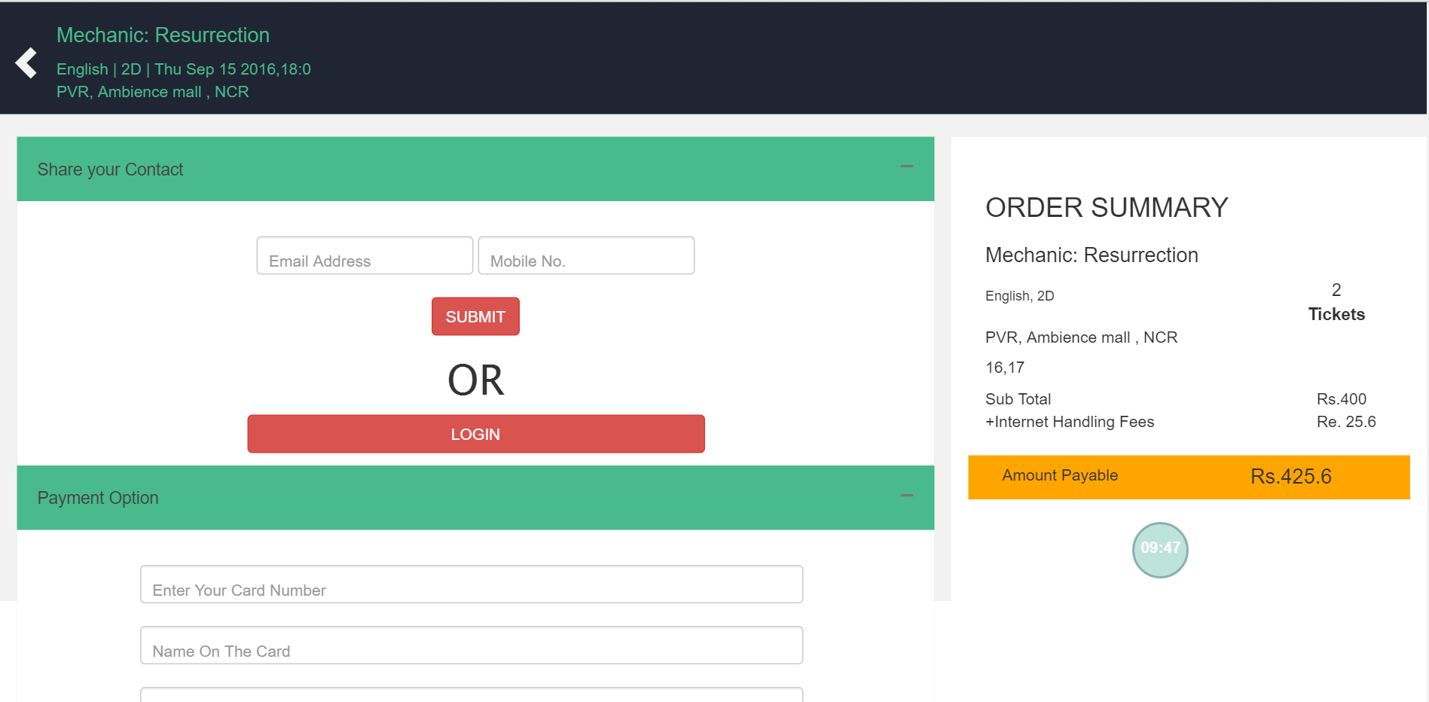
Glimpses

Slide 14
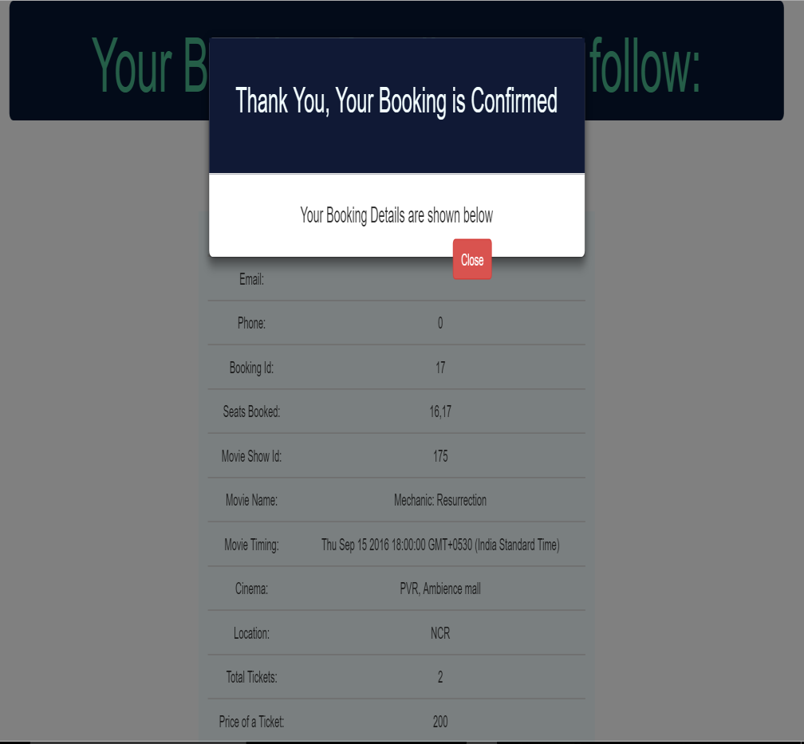
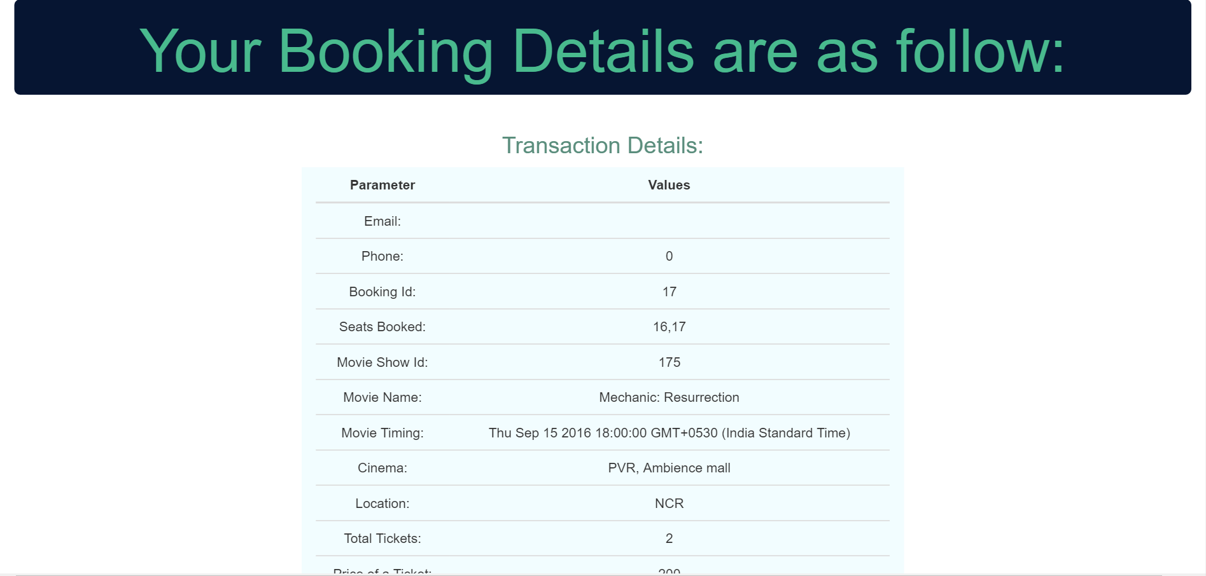
Glimpses

Slide 15
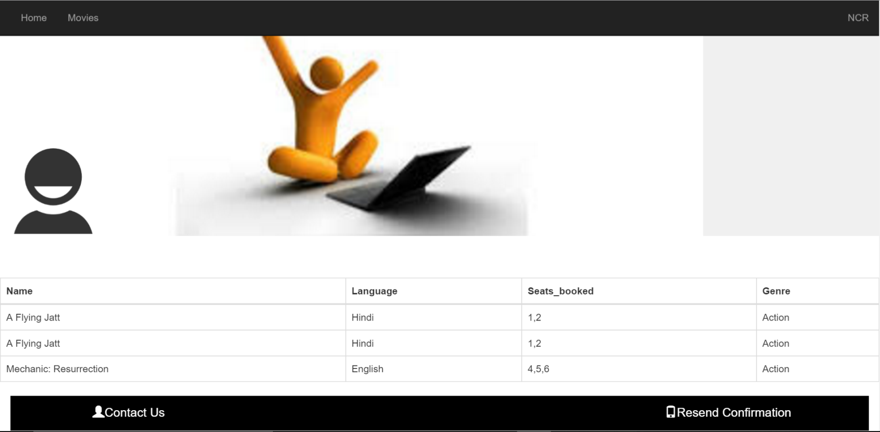
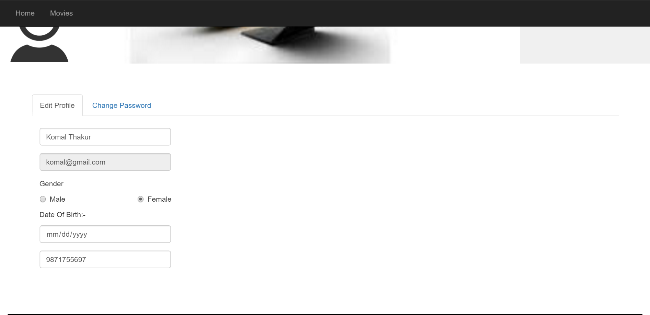
Glimpses

Slide 16
Acknowledgements
We are grateful to the following for their kind help in the completion of the project.
NIIT Technologies for providing us with the opportunity to learn and work on such knowledge and skill enhancing projects.
Ms. Amisha Agarwal and Mrs. Jayanti Bagga for their unflinching guidance and support.
Mr. Shubhanshu Agarwal for the fantastic Logo Design.

Slide 17
References
www.google.com
http://stackoverflow.com/
https://in.bookmyshow.com/
https://www.youtube.com/
http://www.w3schools.com/
http://www.tutorialspoint.com/

Slide 18

Silver Screen Making your Movie experiences Shine.
Team Offline
Ankita Rustagi
Gaurav Kishore
Komal Thakur
Mohini Agarwal
Parveen Arya

